Slide 1
CONTENTS
1. Language Fundamentals
2. Operators
3. Input and Output Statements
4. Flow Control
5. Strings
6. List Data Structure
7. Tuple Data Structure
8. Set Data Structure
9. Dictionary Data Structure
10. Functions
11. Modules
12. Packages
13. Exception Handling
14. File Handling
15. OOPs
16. Regular Expressions

Slide 2
Introduction
Python is an interpreted, high-level, general-purpose programming language.
Created by Guido van Rossum and first released in 1991
Python was developed by Guido van Rossum in 1989 while working at National
Research Institute at Netherlands.
Python was conceived in the late 1980s as a successor to the ABC language.
But Officially Python was made available to public in 1991.
The Official dob for python is :Feb 20th 1991.
It is recommended as first programming language for Beginners.

Slide 3
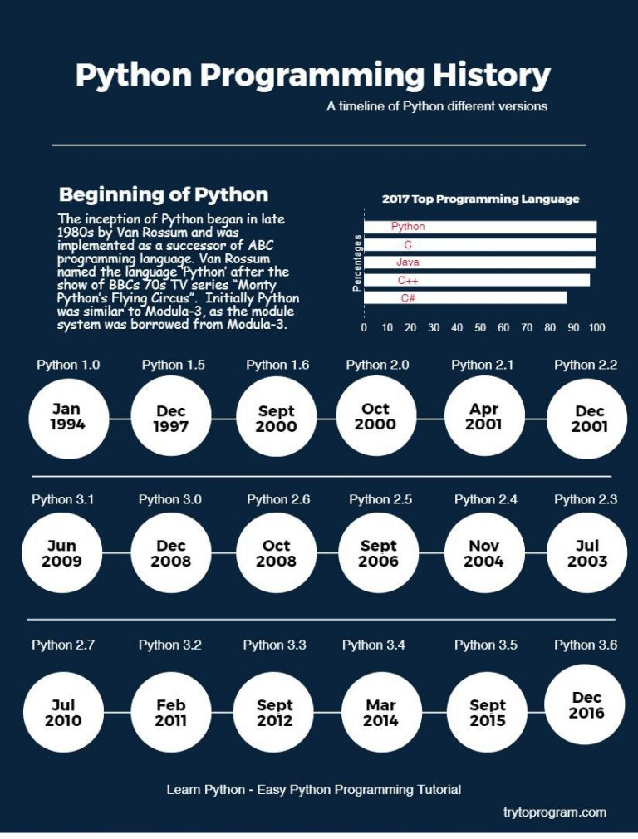

Slide 4
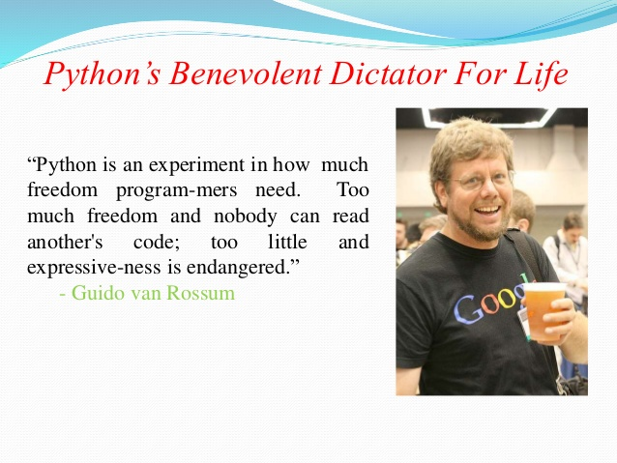

Slide 5
The name Python was selected from the TV Show "The Complete Monty Python's Circus",
which was broadcasted in BBC from 1969 to 1974.
Guido developed Python language by taking almost all programming features from
different languages
1. Functional Programming Features from C
2. Object Oriented Programming Features from C++
3. Scripting Language Features from Perl and Shell Script
4. Modular Programming Features from Modula-3
Most of syntax in Python Derived from C and ABC languages.

Slide 6
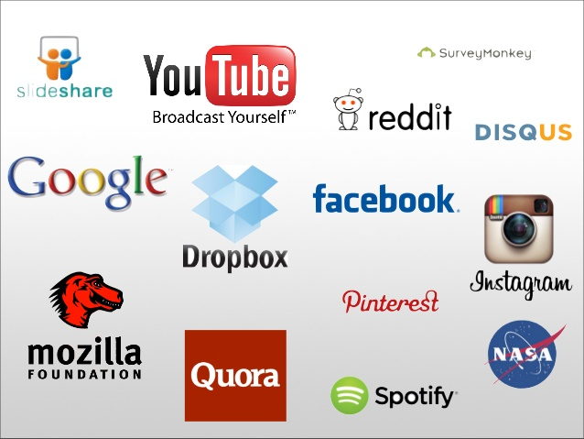
Companies Using Python

Slide 7
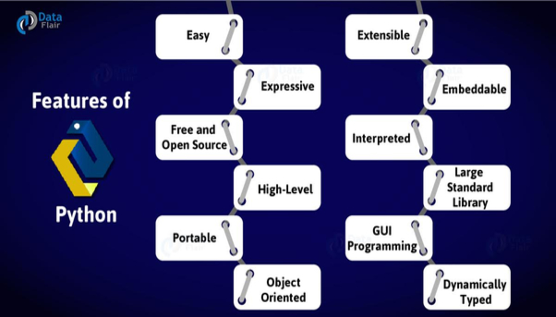

Slide 8
PYTHON INSTALLATION
Python program installers are available for most operating systems at
www.python.org
Python 2 or Python 3 ? Which one to use ?
Python comes with two versions, python 3.6.x and python 2.7.x,
commonly referred as python 3 and python 2.
Python 2 is going to reach the end of its life in 2020,
on the other hand, Python 3. has lot of improvements, new features,
some nice new tricks.
Python 3 installation
Python for Windows
1. Down load python 3.7.x version from https://www.python.org/downloads/ site
Python for Linux
Many of the Unix/Linux distribution have Python 2.7.x pre installed. and some have Python 3.x.x also.

Slide 9
Example:-To print HelloWorld:
Java:
Public class helloworld
{
p s v main(string [] args)
{
Sop(“Helloworld”);
}
}
c:
#include<stdio.h>
void main()
{
print("Hello world");
}
Python:
print("Hello world");

Slide 10
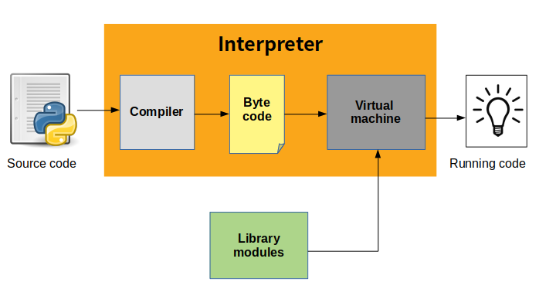
Python Execution

Slide 11
Where we can use Python:
We can use everywhere. The most common important application areas are
1. For developing Desktop Applications
2. For developing web Applications
3. For developing database Applications
4. For Network Programming
5. For developing games
6. For Data Analysis Applications
7. For Machine Learning
8. For developing Artificial Intelligence Applications
9. For IOT

Slide 12
Python Execution Process:-
Python first compiles your source code (.py file) into a format known as byte code .
Compilation is simply a translation step, and byte code is a lower-level, and platform-independent, representation of your source code.
Compiled code is usually stored in .pyc files , and is regenerated when the source is updated, or when otherwise necessary.
In order to distribute a program to people who already have Python installed, you can ship either the .py files or the .pyc files.
The bytecode (.pyc file) is loaded into the Python runtime and interpreted by a Python Virtual Machine .

Slide 13
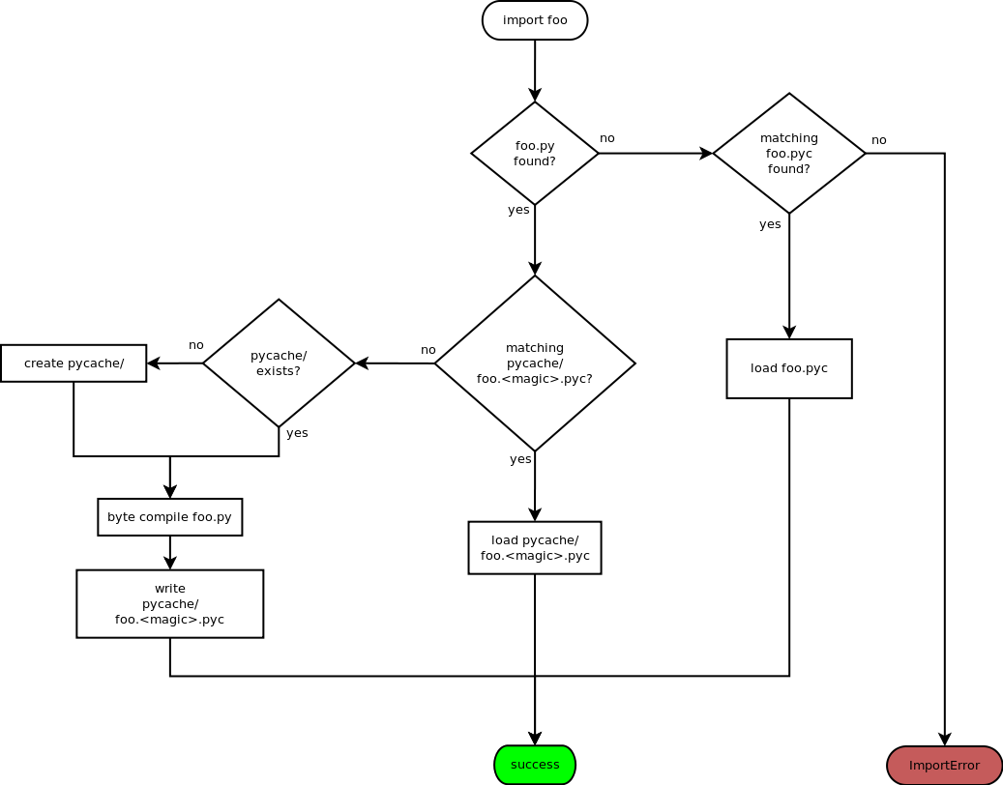
Python PYC Internal Working

Slide 14
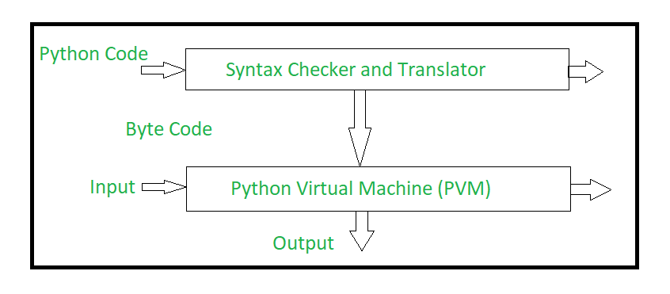

Slide 15
Features of Python:
Simple and easy to learn
Freeware and Open Source
3. High Level Programming language
4. Platform Independent
Portability
Dynamically Typed
7. Both Procedure Oriented and Object Oriented
Interpreted
Extensible
Embedded

Slide 16
Identifiers
A name in Python program is called identifier. It can be class name or function name or module name or variable name.
a = 10
def sum(a,b):
Print(a+b)
Identifier:
1. Alphabet Symbols (Either Upper case OR Lower case)
2. If Identifier is start with Underscore (_) then it indicates it is private.
3. Identifier should not start with Digits.
4. Identifiers are case sensitive.
5. We cannot use reserved words as identifiers Eg: def=10
6. There is no length limit for Python identifiers. But not recommended to use too lengthy identifiers.
7. Dollor ($) Symbol is not allowed in Python.

Slide 17
Data Types
Data Type represent the type of data present inside a variable.
In Python we are not required to specify the type explicitly. Based on value provided, the type will be assigned automatically. Hence Python is Dynamically Typed Language.
Python contains the following inbuilt data types
1. int
2. float
3.complex
4.bool
5.str
6.bytes …

Slide 18
Operators
Operator is a symbol that performs certain operations.
Python provides the following set of operators
1. Arithmetic Operators
2. Relational Operators or Comparison Operators
3. Logical operators
1. Arithmetic Operators:
+ ==>Addition
- ==>Subtraction
* ==>Multiplication
/ ==>Division operator
% ===>Modulo operator
// ==>Floor Division operator
** ==>Exponent operator or power operator

Slide 19
Relational Operators
>,>=,<,<=
These are Relational Operators or Comparison Operators
a=10
b=20
print("a > b is ",a>b)
print("a >= b is ",a>=b)
print("a < b is ",a<b)
print("a <= b is ",a<=b)
a > b is False
a >= b is
a < b is True
a <= b is True

Slide 20
Logical Operators
Logical Operators are and, or ,not
We can apply for all types.
For boolean types behaviour:
and ==>If both arguments are True then only result is True
or ====>If atleast one arugemnt is True then result is True
not ==>complement
Example:-True and False ==>False
Example:- True or False ===>True
Example:- not False ==>True

Slide 21
Eg: 10 and 20 0 and 20
If first argument is zero then result is zero otherwise result is y
x or y:
If x evaluates to True then result is x otherwise result is y
Example:- 10 or 20 ==> 10 0 or 20 ==> 20
not x:
If x is evaluates to False then result is True otherwise False
Example:- not 10 ==>False
Example:- not 0 ==>True

